Slide 1

DriverPass System Analysis
Phillip Kimbrel
Notes:
[No speaker notes required for this slide.]

Slide 2

System Requirements
Schedule Appointments
Deliver Written driving test
Quick preforming
Universal
Notes:
With the DriverPass system we need it to be fast and efficient while also being able to access the product through anything wither it is a smart phone, laptop, or tablet. With this we can have a higher reach of users of our product. The DriverPass system needs to be able to deliver written driving test to our users and also send the completed test to the DMV. Appointment schedules are a necessity for the ability for having people learn how to drive with an instructor.

Slide 3
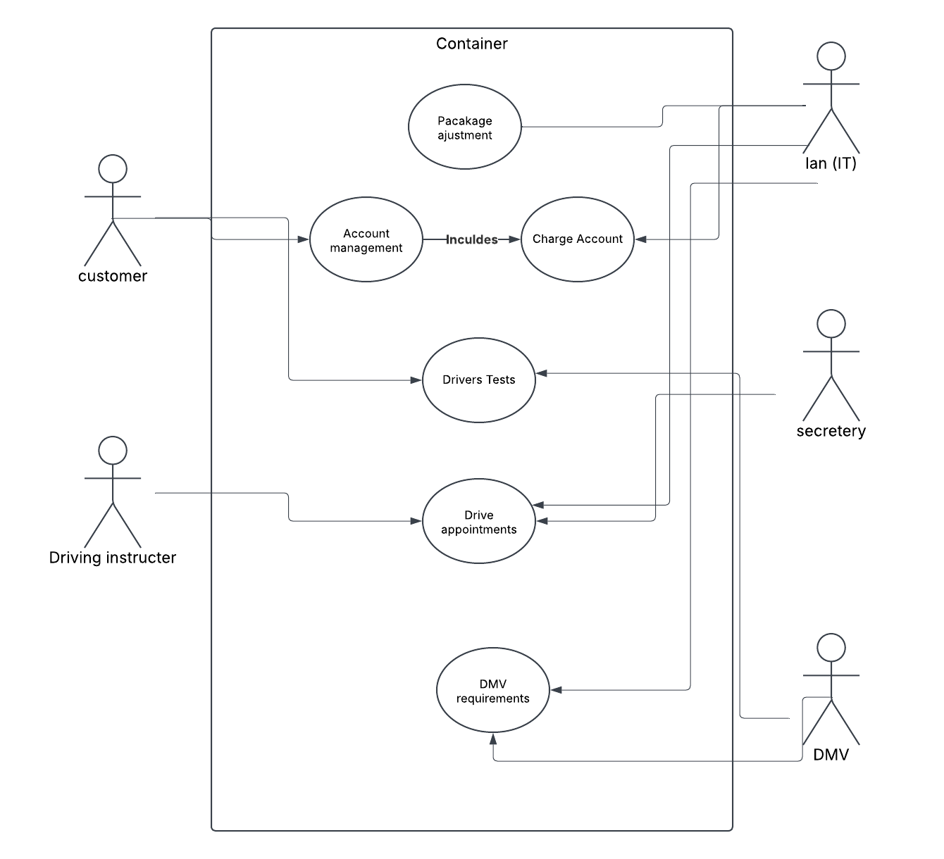
Use Case Diagram
Notes:
In this diagram we have the Customer, Driving instructor, Secertrary, DMV and the IT administrator Ian. Many of these point to a multitude of shared sections from account management, drivers' tests, and driving appointments. This design accounts for everything Drivepass needs as the packages need to be changed , tests needs to be given, and appointments need to be made

Slide 4
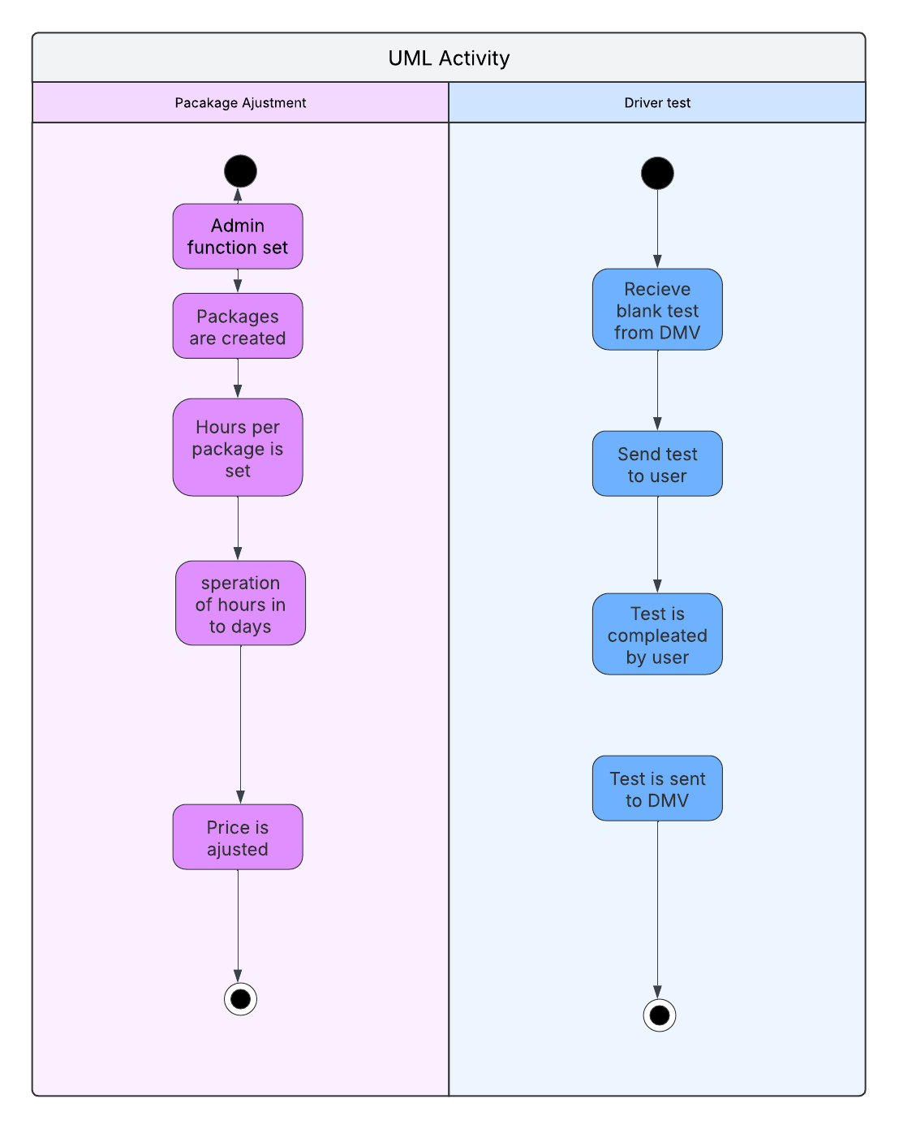
Activity Diagram
Notes:
In these diagrams we show breaking down how we change what comes included in the packages example, how the test are sent to user, received from user, and delivered to the DMV. For example, in package Adjustment we log in to the Admin account change how many packages there are and then change the hours and pricing of the package.

Slide 5
Security
Introduced a restricted admin system
Notes:
Security was thought of in this design by creating an administration section where only the IT manage Ian can work on it. This prevents any user from changing the price and time given from the package.

Slide 6
System Limitations
English only
Must have Valid Email address
Notes:
The Limitations of this design is that users of DrivePass must be able to understand English and have a Valid Email Address. This is the case as the system was only thought for The united states and having a valid email address helps with improving security

